Slide 1
Computer Architecture I
CS-GY-6133
Topic: Caches
Instructor: Siddharth Garg

Slide 2
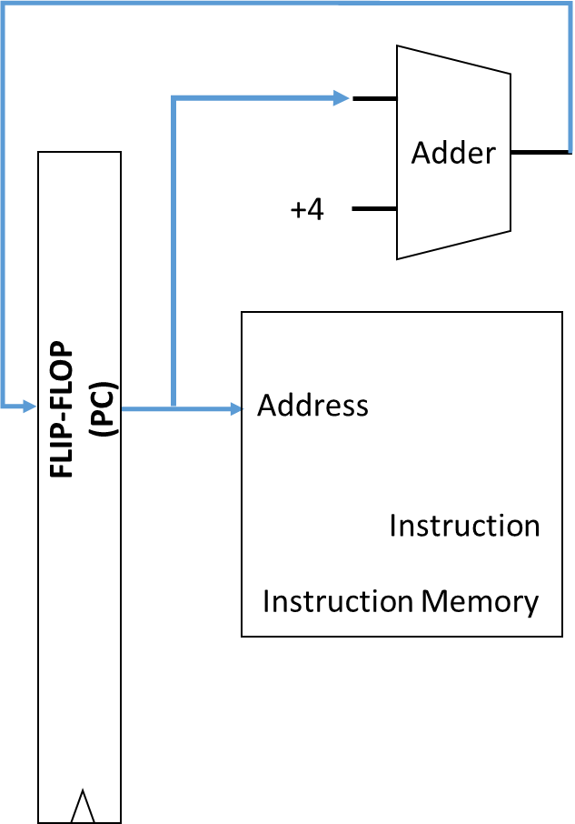
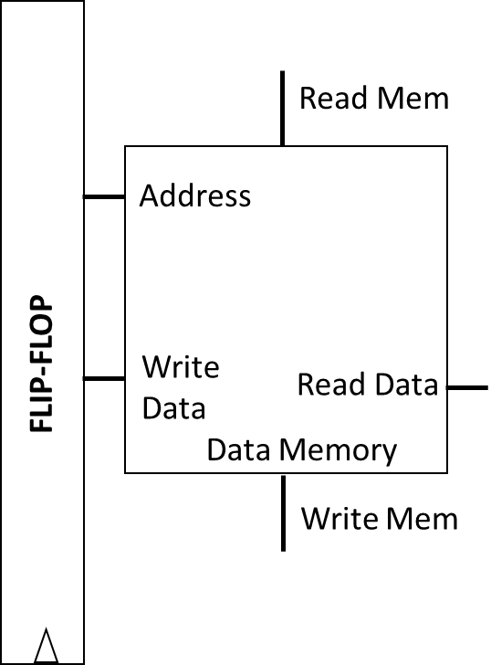
5-Stage Pipeline
Flip-Flop
ID/RF
(Decoder, RF)
Flip-Flop
EX
(ALU)
Flip-Flop
Flip-Flop
WB
(RF)
Flip-Flop
Flip-Flop
IF
(PC, Imem)
MEM
(Dmem)
CLK
CLK
CLK
CLK
CLK
CLK
How are Imem and Dmem implemented?
Note: simplified pictures of IF and MEM stages

Slide 3
Memory System
Processor
Flip-Flop
ID/RF
(Decoder, RF)
Flip-Flop
EX
(ALU)
Flip-Flop
Flip-Flop
WB
(RF)
Flip-Flop
Flip-Flop
CLK
CLK
CLK
CLK
CLK
CLK
Memory Controller
Main Memory
Dynamic Random Access Memory (DRAM)
(Unified instruction and data memory)

Slide 4
DRAM Details
3.6 GHz Pentium 4
Flip-Flop
ID/RF
(Decoder, RF)
Flip-Flop
EX
(ALU)
Flip-Flop
Flip-Flop
WB
(RF)
Flip-Flop
Flip-Flop
CLK
CLK
CLK
CLK
CLK
CLK
Memory Controller
Main Memory
Memory capacity: 4GB
Access Latency: 50 ns/word = ?? Clock cycles/word
= 50 ns / (1/3.6) ns = 180 cycles

Slide 5
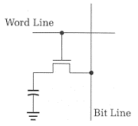
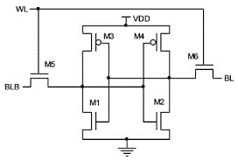
Memory Technologies
 | DRAM | SRAM (512 KB) | SRAM (4 MB)
Cell | 1 Transistor, 1 Capacitor (1T-1C) | 6 Transistor (6T) | 6 Transistor (6T)
Density (bits/um²) | High | Low | Low
Access Latency (ns) | Large | Small | Medium

Slide 6
Memory Hierarchy
Cache = “temporary storage space”
Instead of slow off-chip access to large DRAM, store frequently used data in on-chip SRAM cache
Hierarchy:
L1 Cache: small (32 KB), very fast (typically 1 clock cycle)
L2 Cache: larger (1 MB), slower (10s of nsecs)
L3 Cache: even larger ….
Main Memory: 4GB, 100s of nsecs
Decoder, RF, EX
CPU
SRAM
L1 Cache
SRAM
L2 Cache
DRAM Main Memory

Slide 7
Locality
Decoder, RF, EX
CPU
Temporal locality: if you’ve accessed some data, you’ll likely access it again in the near future
Same instructions are repeatedly accessed within loops
For example the loop counter
Spatial locality: if you’ve accessed some data, you’ll likely access nearby data
Array accesses
Instruction are accessed in sequential order
SRAM
L1 Cache
SRAM
L2 Cache
DRAM Main Memory

Slide 8
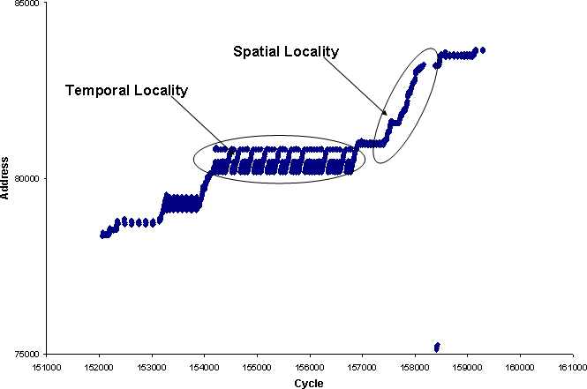
Access Pattern Exhibiting Locality
http://www.eetimes.com/document.asp?doc_id=1275470

Slide 9
Cache Organization
Caches store data in chunks of “cache blocks”
Access to a cache returns an entire cache block
A block can be as small as 1 byte, but can be larger (example: 4 bytes)
Where does a block go when it is fetched into cache? (Placement)
How do we know if a block already exists in the cache? (Identification)
Which block should we kick out if there isn’t enough room? (Replacement)
32 KB cache
1 Byte cache block
i.e., 32768 blocks
32 bit address
from CPU

Slide 10
Direct Mapped Cache
Assume 32 KByte cache with a 1 Byte cache block
Note that 32KB = 2¹⁵ Bytes = 32768 Bytes
1 Byte = 8 bits
Block 0
Address 0, 32768, 2*32768, …
Block 1
Address 1, 32769, 2*32768+1, …
Block 2
Address 2, 32770, 2*32768+2, …
32 bit address
from CPU
Block 32767
Address 32767, 65535, …

Slide 11
Direct Mapped Cache: Placement
Each block in the cache has a log₂(32768) = 15 bit “index”
Index
Block 0
Address 0, 32768, 2*32768, …
32 bit address
from CPU
Block 1
Address 1, 32769, 2*32768+1, …
Block 2
Address 2, 32770, 2*32768+2, …
Index
(15 bits)
15 LSBs of address are used to look up (index) into the cache
Block 32767
Address 32767, 65535, …

Slide 12
Direct Mapped Cache: Identification
32 bit address
Data Array
(8 bits)
Tag Array
(17 bits)
Tag
(17 bits)
Index
(15 bits)
Block 0
Tag 0
Addr 0
0…………………….00
0….00
Block 1
Tag 1
Addr 32768
0…………………….01
0….00
Block 2
Tag 2
How do we know which block of data is stored?
Addr ….
1…………………….11
0….00
Block 32767
Tag 32767

Slide 13
Direct Mapped Cache: Replacement
32 bit address
Data Array
(8 bits)
Tag Array
(17 bits)
Tag
(17 bits)
Index
(15 bits)
Data[0]
0…………… 00
Data[32768]
Tag 0
Block 0
0…………… 01
Access 1
0…………………….00
0….00
Miss
Data[1]
Tag 1
Block 1
0…………… 00
Access 2
0…………………….00
0….00
Hit
Block 2
Tag 2
Access 3
0…………………….01
0….00
Miss
Access 4
0…………………….00
0….01
Miss
Block 32767
Tag 32767

Slide 14
Direct Mapped Cache: Replacement
32 bit address
Data Array
(8 bits)
Tag Array
(17 bits)
Valid
(1 bit)
Tag
(17 bits)
Index
(15 bits)
Data[0]
1
Data[32768]
Tag 0
Block 0
0…………… 00
0
Access 1
0…………………….00
0….00
Miss
0
Block 1
Tag 1
1
Data[32769]
0…………… 01
Access 2
Block 2
Tag 2
0…………………….00
0….00
Hit
Access 3
0…………………….01
0….00
Miss
Block 32767
Tag 32767
0

Slide 15
Cache Operation
Data Array
(8 bits)
Tag Array
(17 bits)
Valid
(1 bit)
Address (32 bits)
Tag
(17 bits)
Index
(15 bits)
Block 0
Tag 0
V 0
0
Block 1
Tag 1
0
V 1
Block 2
Tag 2
V 2
Block 32767
Tag 32767
V..
1
=
&
0
0
MISS
Output Data if HIT
1
HIT

Slide 16
Alternative Placement
Assume 32 KByte cache with a 1 Byte cache block
1 Byte = 8 bits
Use 15 MSBs of address to determine index
Consider following stream of accesses:
Addr 0, Addr 1, Addr 0, Addr 1,..
Block 0
Address 0, 1, 2, 3, …..
Block 1
Address 32768, ….
Block 2
Bad Idea!
Block 32767

Slide 17
Set Associative Caches
Direct mapped caches can have miss rate due to conflicts
Each address maps to a unique location in the cache
Assume addresses A and B with same index bits
Sequence: A, B, A, B, A….. results in 100% cache miss rate!
Set-associative cache: each address can map to N different locations in the cache!
“N-way” set associative cache
2-way set associate cache has ~0% cache miss rate for sequence A, B, A, B …

Slide 18
2-Way Set Associative Cache
2-way set-associative 32 KB cache with 1 Byte blocks
Data Array
(8 bits)
Tag Array
(? bits)
Valid
(1 bit)
Data Array
(8 bits)
Tag Array
(? bits)
Valid
(1 bit)
Set 0
Set 1
Set 16383
Way 0
Way 1

Slide 19
Placement
Tag
(? bits)
Index
(14 bits)
Tag
(18 bits)
Index
(? bits)
Data mapped to a unique set but can be placed in either way
Data Array
(8 bits)
Tag Array
(? bits)
Valid
(1 bit)
Data Array
(8 bits)
Tag Array
(? bits)
Valid
(1 bit)
Set 0
Set 1
Set 16383
Way 0
Way 1

Slide 20
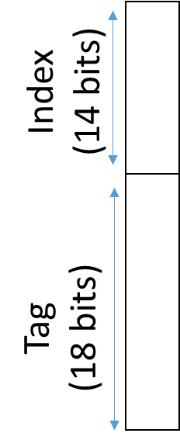
Identification
Way 0
Way 1
Data Array
(8 bits)
Tag Array
(18 bits)
Valid
(1 bit)
Data Array
(8 bits)
Tag Array
(18 bits)
Valid
(1 bit)
=
&
=
&
HIT?
HIT?

Slide 21
Replacement
(Addresses A, B, C map to same set)
Way 0
Way 1
Data Array
(8 bits)
Tag Array
(18 bits)
Valid
(1 bit)
Data Array
(8 bits)
Tag Array
(18 bits)
Valid
(1 bit)
Data[A]
Tag[A]
1
Data[B]
Tag[B]
1
Sequence: A B B A A A A C
Where should C go?
M
M
H
H
H
H
H
M

Slide 22
Least Recently Used (LRU)
Way 0
Way 1
Data Array
(8 bits)
Tag Array
(18 bits)
Valid
(1 bit)
Data Array
(8 bits)
Tag Array
(18 bits)
Valid
(1 bit)
Data[A]
Data[B]
Tag[B]
1
Tag[A]
1
Data[C]
Tag[C]
Evicted!
Sequence: A B B A A A A C
Replace least recently used block
M
M
H
H
H
H
H
M

Slide 23
Implementing LRU
Way 0
Way 1
Data Array
(8 bits)
Tag Array
(18 bits)
Valid
(1 bit)
Data Array
(8 bits)
Tag Array
(18 bits)
Valid
(1 bit)
MRU
(1 bit)
Tag[B]
1
1
Data[A]
0
Tag[A]
1
Data[B]
0
Sequence: A B B A A A A C
LRU = NOT MRU
M
M
H
H
H
H
H
M

Slide 24
Practical LRU Implementation
LRU is hard to implement in hardware for N>2
Keep track of all possible N! orderings of N ways
A linked list in which the head points to MRU and tail points to LRU
Example: N=4; 4 x 2 bits = 8 bits per cache set and extra logic to update list on every access
Alternative policies that are more hardware friendly
NOT MRU: same as LRU for N=2, requires only log(N) bits, easy update
Hierarchical: for N=4, divide ways into 2 groups of 2 ways

Slide 25
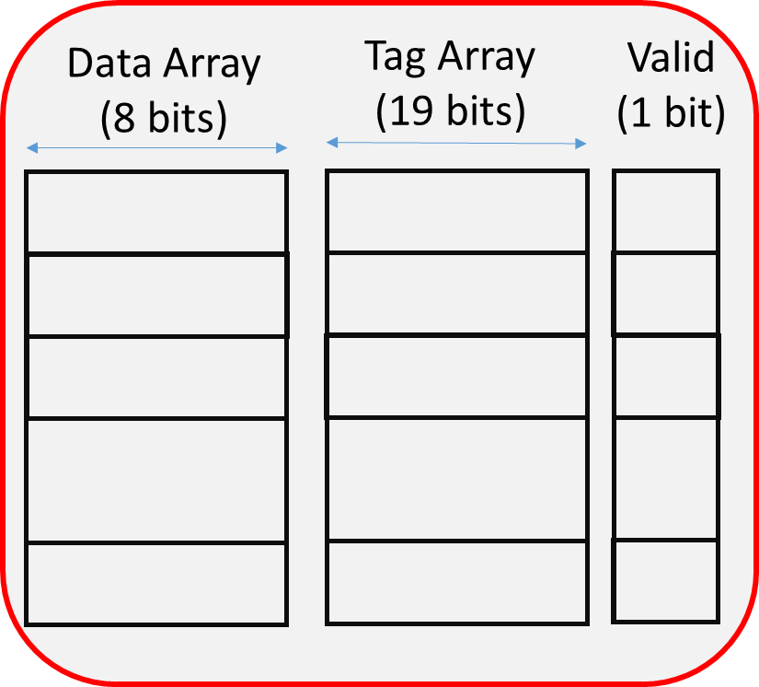

Hierarchical LRU Implementation
MRU Way
(G0)
MRU Way (G1)
Way 0
Way 1
Way 2
Way 3
MRU Grp
A
B
C
D
Group 0
Group 1
Sequence | A | C | D | B | A | A | E
MRU Grp | 0 | 1 | 1 | 0 | 0 | 0
MRU Way (G0) | 0 | 0 | 0 | 1 | 0 | 0
MRU Way (G1) | - | 2 | 3 | 3 | 3 | 3
Which block is evicted?

Slide 26
Hierarchical LRU Implementation
MRU Way
(G0)
MRU Way (G1)
Way 0
Way 1
Way 2
Way 3
MRU Grp
A
B
C
D
Group 0
Group 1
Sequence | A | C | D | B | A | D | E
MRU Grp | 0 | 1 | 1 | 0 | 0 | 1
MRU Way (G0) | 0 | 0 | 0 | 1 | 0 | 0
MRU Way (G1) | - | 2 | 3 | 3 | 3 | 3
Which block is evicted?
Not the true LRU block!

Slide 27
Exploiting Spatial Locality
Tag
(17 bits)
Index
(12 bits)
Offset
(3 bits)
Recall that if the byte from address i is accessed, then byte from address i+1 is likely to be accessed
Pull in multiple contiguous bytes of data in each access
Use larger block size!
Example: 32KB direct mapped cache with 8 Byte (64 bit) blocks
i.e., cache has 4096 Byte blocks
Selects a byte from the block
Selects a block
Tag 0
Block 0
Block 1
Tag 4095
Block 4071
Valid
Tag Array
(17 bits)
Data Array
(8 bytes)

Slide 28
Cache Operation
Data Array
(8 bytes)
Tag Array
(17 bits)
Valid
(1 bit)
Address (32 bits)
Tag
(17 bits)
Index
(12 bits)
Offset
(3 bits)
Block 0
Tag 0
V 0
0
Block 1
Tag 1
0
V 1
Block 2
Tag 2
V 2
Block 4095
Tag 4095
V..
8 Bytes
1
=
&
0
0
8:1 MUX
MISS
Output Data if HIT
1 Bytes
1
HIT

Slide 29
Impact of Block Size
Sequence of addresses: A, A+1, A+2, A+3 …
4 consecutive misses for 1 byte block size
1 miss and 3 hits for 4 byte block size
Small block sizes don’t exploit any spatial locality
What happens if the block size increases for the same cache size
Fewer number of larger blocks
[Source: D Brooks CS146 Lecs]

Slide 30
In Class Exercise 1
Determine the number of offset bits, index bits and tag bits for a 4-way, 8KB cache with 8 Byte blocks. Assume that the cache is Byte addressable with a 32 bit address.
Offset: 3 bits (8 byte blocks that are byte addressable)
Number of sets: 2¹³ bytes / ( 4 ways x 8 bytes per way) = : 2¹³ bytes / 2⁵ bytes = 2⁸ sets
Index: 8 bits
Tag: 32 – 8 – 3 = 21 bits

Slide 31
Write Policies
What should we do on a cache store/write access
Cannot perform tag look-up and write to the data array in parallel (why?)
First access tag array and if there is a write hit, write to the data array
Increases the delay of a cache access (recall: period is determined by the worst-case)
What do on a write hit?
When there is a tag match (i.e., block exists in cache)
What to do on a write miss?
When the data block is not in the cache?

Slide 32
Write Hit Policies
When to propagate new (“dirty”) values to lower levels
Write-back policy: lazy, take care of it later
Write-through policy: update lower levels immediately
Write-back policy
Modify the data in the current cache level only
When to update the data in the lower level? When cache block is evicted
Dirty bit per cache block to keep track of blocks that have been updated
Pros
Write happens at speed of current cache level
multiple writes to the same block result in only one write back to main memory
Cons
Evictions take more time
Data inconsistency between cache and lower levels

Slide 33
Write Back Cache (32 KB, Direct Mapped, 1 Byte Block)
Data Array
(8 bits)
Dirty
(1 bit)
Tag Array
(17 bits)
Valid
(1 bit)
Write Address (32 bits)
Tag
(17 bits)
Index
(15 bits)
Block 0
D 0
Tag 0
V 0
0
0
Block 1
0
Tag 1
0
D 1
V 1
Block 2
1
Tag 2
V 2
0
Block 32767
Tag 32767
V..
Write Data
(8 bits)
1
=
&
“Write Hit on Clean Data”
1
HIT

Slide 34
Write Back Cache (32 KB, Direct Mapped, 1 Byte Block)
Data Array
(8 bits)
Dirty
(1 bit)
Tag Array
(17 bits)
Valid
(1 bit)
Write Address (32 bits)
Tag
(17 bits)
Index
(15 bits)
Block 0
D 0
Tag 0
V 0
0
0
Block 1
0
Tag 1
0
D 1
V 1
Block 2
1
Tag 2
V 2
1
Block 32767
Tag 32767
V..
Write Data
(8 bits)
1
=
&
“Write Hit on Dirty Data”
1
HIT

Slide 35
Write Back Cache (32 KB, Direct Mapped, 1 Byte Block)
Data Array
(8 bits)
Dirty
(1 bit)
Tag Array
(17 bits)
Valid
(1 bit)
Read Address (32 bits)
Tag
(17 bits)
Index
(15 bits)
Block 0
D 0
Tag 0
V 0
0
0
Block 1
0
Tag 1
0
D 1
V 1
Block 2
1
Tag 2
1
Block 32767
Tag 32767
V..
0
=
&
“Read Miss on Dirty Data”
WRITE-BACK DATA
0
MISS

Slide 36
Write Back Cache (32 KB, Direct Mapped, 1 Byte Block)
Data Array
(8 bits)
Dirty
(1 bit)
Tag Array
(17 bits)
Valid
(1 bit)
Read Address (32 bits)
Tag
(17 bits)
Index
(15 bits)
Block 0
D 0
Tag 0
V 0
0
0
Block 1
0
Tag 1
0
D 1
V 1
DISCARD DATA
Tag 2
1
Block 2
0
Block 32767
Tag 32767
V..
0
=
&
“Read Miss on Clean Data”
0
MISS

Slide 37
Write Hit Policies
When to propagate new (“dirty”) values to lower levels
Write-back policy: lazy, take care of it later
Write-through policy: update lower levels immediately
Write-Through policy
Update lower levels of cache/memory on every write
No need for a dirty bit in the cache
Pros
Reduces complexity of cache (no dirty bit)
Reads never cause write-backs
Consistency across levels of memory hierarchy
Cons
Increased write bandwidth (multiple writes to same block)
Potentially Increased write latency (wait for write to propagate to lower levels?)

Slide 38
Write Through Cache (32 KB, Direct Mapped, 1 Byte Block)
Data Array
(8 bits)
Tag Array
(17 bits)
Valid
(1 bit)
Write Address (32 bits)
Tag
(17 bits)
Index
(15 bits)
Block 0
Tag 0
V 0
0
Block 1
Tag 1
0
V 1
Block 2
Tag 2
V 2
Update data in cache
Block 32767
Tag 32767
V..
Write Data
(8 bits)
1
=
&
Write-Through to Lower Level
1
HIT

Slide 39
Write Through Cache (32 KB, Direct Mapped, 1 Byte Block)
Data Array
(8 bits)
Tag Array
(17 bits)
Valid
(1 bit)
Read Address (32 bits)
Tag
(17 bits)
Index
(15 bits)
Block 0
Tag 0
V 0
0
Block 1
Tag 1
0
V 1
Block 2
Tag 2
1
DISCARD DATA
Block 32767
Tag 32767
V..
0
=
&
0
MISS

Slide 40
Write Miss Policies
What to do if a write access misses in the cache
Write allocate policy
Write no-allocate policy
Write-allocate Policy
Treat like a read miss, allocate block in cache for data
Standard write hit actions follow
Good match for write-back caches
Write no allocate Policy
Do not allocate a cache block for the write, instead forward write to the next level
This implies that only a read access will result in allocations
Goes well with write through policy

Slide 41
Summary of Write Policies
Write Policy | Write Hit or Miss | Where is Update Performed
Write Back, Allocate | Hit/Miss | L1
Write Back, No Allocate | Hit
Write Back, No Allocate | Miss
Write Through, Allocate | Hit/Miss
Write Through, No Allocate | Hit
Write Through, No Allocate | Miss
L1
L2
L1 and L2
L1 and L2
L2

Slide 42
Types of Cache Misses
Compulsory or “cold’’ misses: miss occurs on first access to a memory address
All the misses that would be incurred by a fully-associative, infinitely sized cache
What is a fully-associate cache: any block can go anywhere! Impractical to implement
Capacity misses: Misses that result as a consequence of finite cache size
Misses incurred by finite sized, fully associative cache minus compulsory misses
Conflict misses: Misses that result as a consequence of limited associativity
Misses incurred by finite sized, associative cache minus compulsory and capacity misses

Slide 43
Miss Types

Slide 44
Cache Performance
L1
1 Cycle,
5% miss rate
Average Memory Access Time (AMAT)
AMAT_{L1} = Hit Access Time_{L1} + Miss Rate_{L1} * Miss Access Time_{L1}
Miss Access Time_{L1} = AMAT_{L2}
AMAT_{L2} = Hit Access Time_{L2} + Miss Rate_{L2} * Miss Access Time_{L2}
Miss Access Time_{L2} = Main Memory Access Time
Compute the AMAT of this memory hierarchy.
AMATL2 = 10 + 0.005*100 = 10.5
AMATL1 = 1 + 0.05*10.5 = 1.525
L2
10 Cycles,
0.5% miss rate
Main Memory (100 cycs)

Slide 45
Minimizing Miss Rate
Increase cache size, associativity
Affects cache access time, so AMAT may actually increase!
Increase cache block size
Trade-off between compulsory and conflict misses
Pick optimal block size
Multi-level caches (more later)
Other commonly used optimizations
Victim caches
Critical word first

Slide 46
Victim Cache
Direct mapped caches are “cheap” but result in high conflict miss rate
A fully associative cache is expensive, but has low conflict miss rate
A victim cache is a small (4-8 entry) fully associative cache that holds blocks evicted due to conflict misses
On path between L1 and L2
Checked on L1 miss
Hit in victim cache -> swap with block in L1

Slide 47
32 KB Direct Mapped Cache with 1 Byte Blocks + Victim Cache
Data Array
(8 bits)
Tag Array
(17 bits)
Valid
(1 bit)
Address B (32 bits)
Tag
(17 bits)
Index
(15 bits)
Block 0
Tag 0
V 0
0
Block 1
Tag 1
0
V 1
Mem[B]
Tag[A]
1
Mem[A]
Tag[B]
Block 32767
Tag 32767
V..
1
=
&
0
0
Mem[A]
Tag[A]
0
MISS
1
Single Entry Victim Cache

Slide 48
32 KB Direct Mapped Cache with 1 Byte Blocks + Victim Cache
Data Array
(8 bits)
Tag Array
(17 bits)
Valid
(1 bit)
Address A (32 bits)
Tag
(17 bits)
Index
(15 bits)
Block 0
Tag 0
V 0
0
Block 1
Tag 1
0
V 1
Mem[B]
Tag[A]
1
Mem[A]
Mem[A]
Tag[B]
Tag[A]
Block 32767
Tag 32767
V..
1
=
&
0
0
Mem[B]
0
HIT
MISS
Mem[A]
Tag[B]
Tag[A]
1
Single Entry Victim Cache

Slide 49
Multi-Level Caches
Partitioned L1-I and L1-D cache
Reminiscent of Harvard architecture
Why is this useful?
Inclusive vs. exclusive cache hierarchy
Inclusive: everything in the L1-I and L1-D caches is also in the L2 cache, but not vice-versa
Miss in L1 fetches data into both L2 and L1
Eviction from L1 need not evict from L2
Eviction from L2 must also evict from L1
What if L2 block size is larger than L1 block size?
L1-D
Data Only
L1-I
Instructions only
Larger, higher associativity, larger block size
Unified L2
Both instructions and data

